Slide 1
Non-synthesizable VHDL
Poor Design Practices
ECE 545
Lecture 10b

Slide 2
Required reading
P. Chu, RTL Hardware Design using VHDL
  Chapter 9.1, Poor design practices and
  their remedies

Slide 3
Non-synthesizable VHDL

Slide 4
Delays
Delays are not synthesizable
Statements, such as
wait for 5 ns
a <= b after 10 ns
will not produce the required delay, and
should not be used in the code intended
for synthesis.

Slide 5
Initializations
Declarations of signals (and variables)
with initialized values, such as
SIGNAL a : STD_LOGIC := ‘0’;
cannot be synthesized, and thus should
be avoided.
If present, they will be ignored by the
synthesis tools.
Use set and reset signals instead.

Slide 6
Dual-edge triggered register/counter (1)
In FPGAs register/counter can change only
at either rising (default) or falling edge of the
clock.
Dual-edge triggered clock is not synthesizable
correctly, using either of the descriptions
provided below.

Slide 7
Dual-edge triggered register/counter (2)
PROCESS (clk)
BEGIN
IF (clk’EVENT AND clk=‘1’ ) THEN
counter <= counter + 1;
ELSIF (clk’EVENT AND clk=‘0’ ) THEN
counter <= counter + 1;
END IF;
END PROCESS;

Slide 8
Dual-edge triggered register/counter (3)
PROCESS (clk)
BEGIN
IF (clk’EVENT) THEN
counter <= counter + 1;
END IF;
END PROCESS;
PROCESS (clk)
BEGIN
counter <= counter + 1;
END PROCESS;

Slide 9
Poor Design Practices

Slide 10
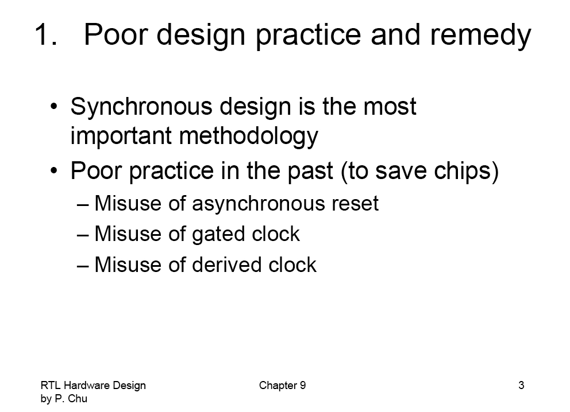

Slide 11
Misuse of Asynchronous Reset

Slide 12
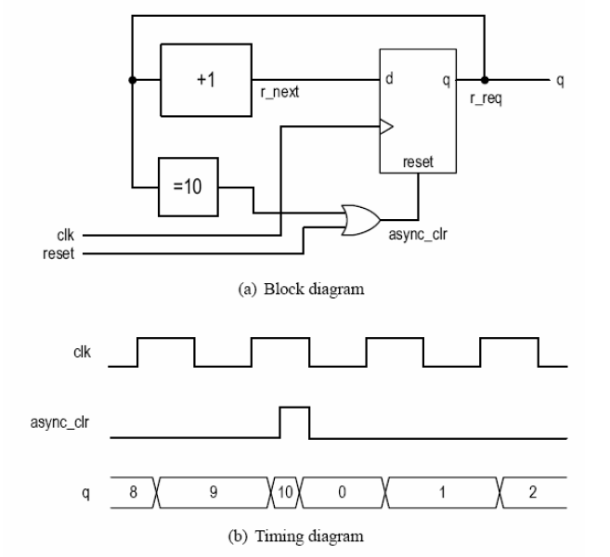

Slide 13
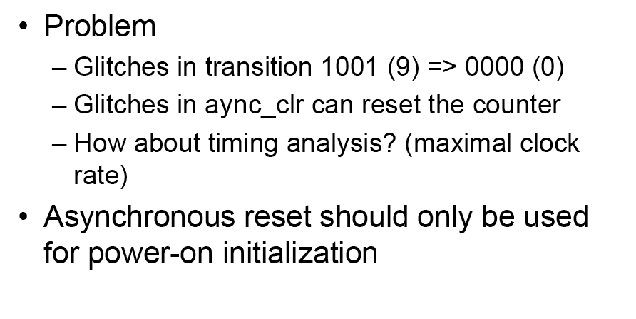

Slide 14
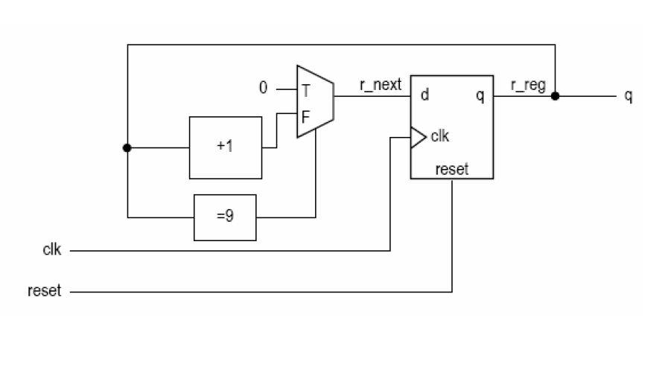

Slide 15
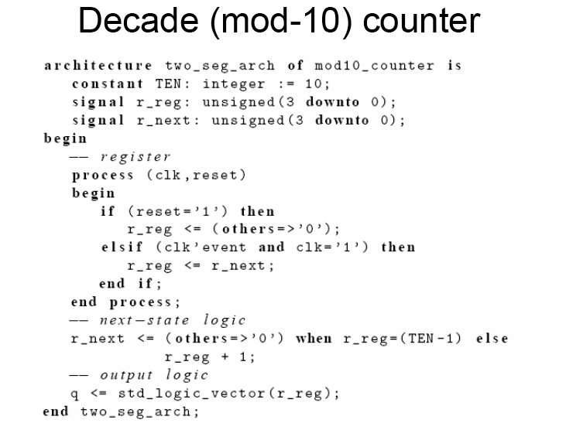

Slide 16
Misuse of Gated Clock

Slide 17
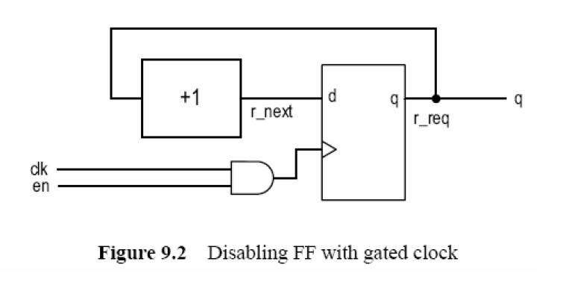

Slide 18
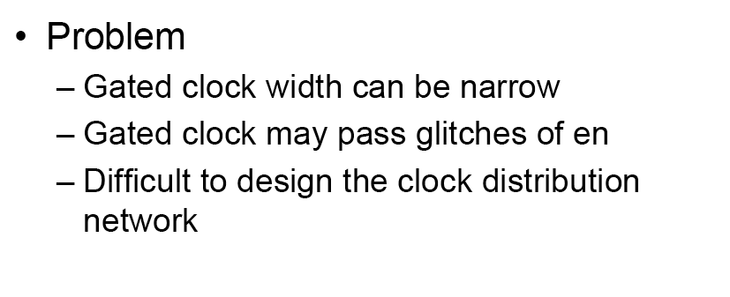

Slide 19
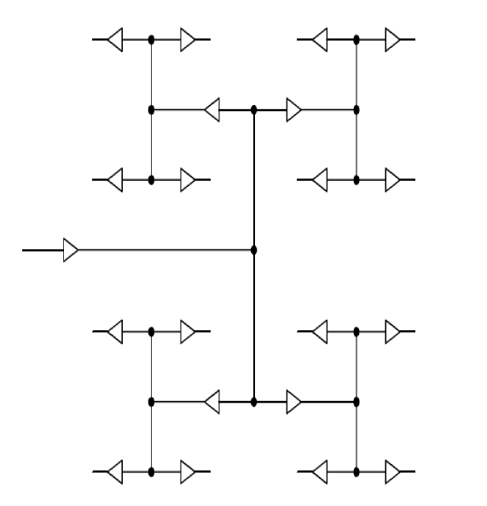
Dedicated Clock Tree Network – H Tree

Slide 20
Misuse of Derived Clock

Slide 21
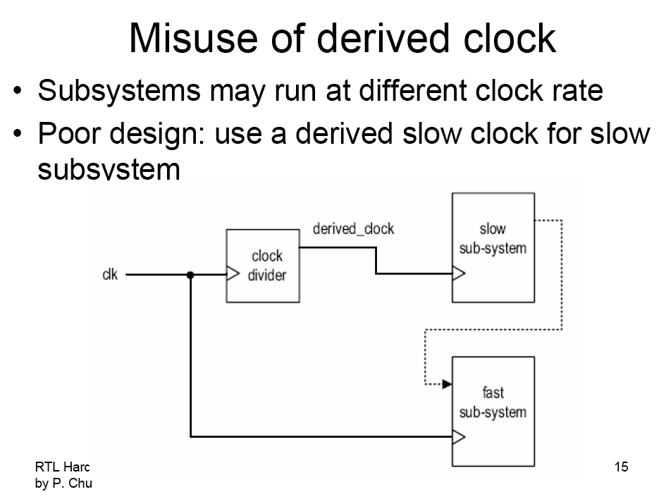

Slide 22
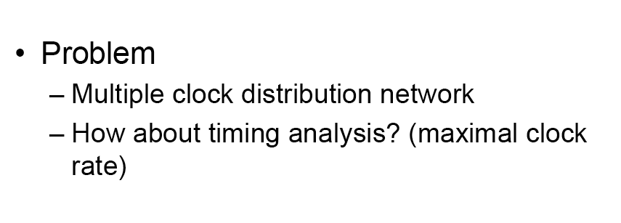

Slide 23
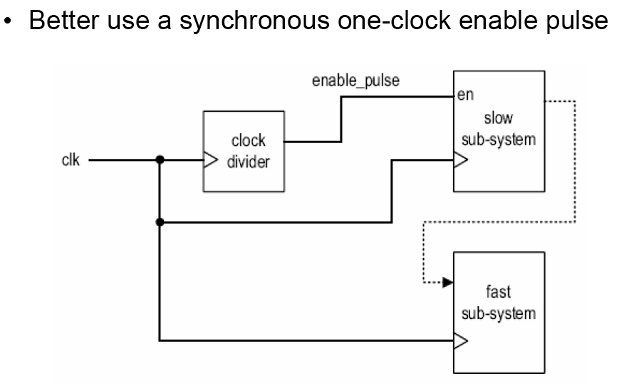

Slide 24
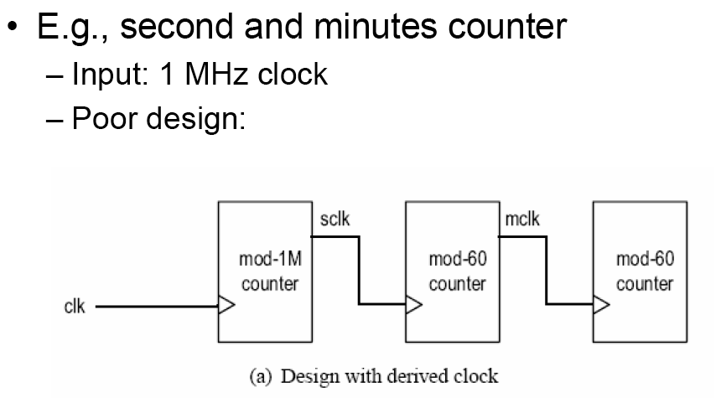

Slide 25
